Slide 1
Delivering Data Agile Data Meet Up November 2018
JON DOWNING

Slide 2
CHASM
NASCENT
EARLY
ADOPTION
CORPORATE
ADOPTION
MATURE /
VISIONARY
PRE-ADOPTION
https://tdwi.org/pages/maturity-model/
Notes:
Data Maturity Model

Slide 3

Build as a process for change
Notes:
This is organizational change
No IT project is delivered in isolation

Slide 4
1. Continuous delivery 2. Architecture 3. Product and process 4. Culture
Notes:
Organizational change requires the above

Slide 5

Continuous Delivery
A process for delivery
A distinction in roles
An understanding of constraints
Continuous Delivery (Or at least towards it!)

Slide 6





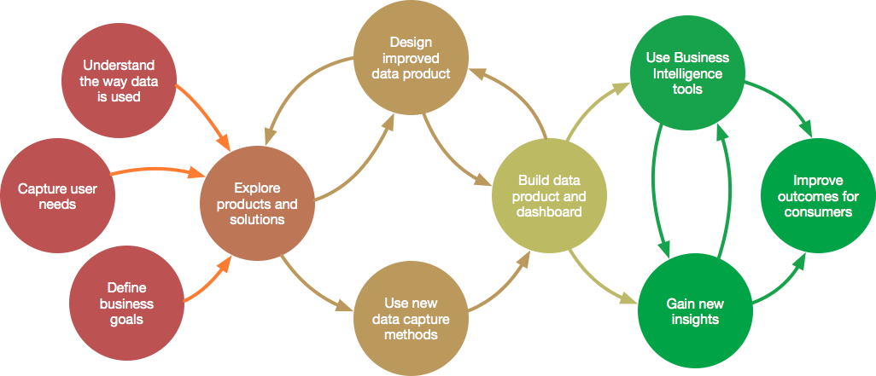
Define
Explore
Design
Build
Use
Notes:
This is a process we have used to deliver data products

Slide 7
Define
Explore
Design
Build
Use
User Research
Data BA
Data BA
Dev Team
BI Dev
BA
Data Science
Data Science
Data Science
Notes:
It requires these people
Note business analyst
Data business analyst

Slide 8
Data BA = Data Outcomes
How to shape process improvement given new technology / new data sets
Define
Explore
Design
Build
Use
User Research
Data BA
Data BA
Dev Team
BI Dev
BA
Data Science
Data Science
Data Science
BA = Business Outcomes
Who is involved, their interaction and the use of (data) outputs towards business aims
Notes:
Note business analyst
Data business analyst

Slide 9
Defined Requirements
Time
Functionality Delivered
Time
User Research
BA
Data BA
Developers
Notes:
They work together broadly like this!

Slide 10
Defined Requirements
Time
Functionality Delivered
Time
User Research
BA
Data BA
Developers

Slide 11
Defined Requirements
Functionality Delivered
User Research
BA
Data BA
Developers

Slide 12
Defined Requirements
Functionality Delivered
User Research
BA
Data BA
Developers

Slide 13
There are many roles in Data Teams
Delivery Manager
Architect
Business Analyst
Data Business Analyst
Data Engineer
Data Quality Assurance Engineer
Data
Scientist
DevOps
Notes:
Teams can have many forms

Slide 14
Data Platform Build
Delivery Manager
Architect
Business Analyst
Data Business Analyst
Data Engineer
Data Quality Assurance Engineer
Data Business Analyst
Data Engineer
DevOps
DevOps

Slide 15
Data Engineering – Defined problem (Existing Tech)
Delivery Manager
Architect
Data Business Analyst
Data Engineer
Data Quality Assurance Engineer
DevOps

Slide 16
Data Science – Defined problem space (Existing Tech)
Delivery Manager
Data Business Analyst
Data Engineer
Data Quality Assurance Engineer
Data
Scientist

Slide 17
Data Science – Undefined problem space (Existing Tech)
Delivery Manager
Architect
Business Analyst
Data Business Analyst
Data Engineer
Data Quality Assurance Engineer
Data Engineer
Data
Scientist
DevOps

Slide 18
Data Product Development
BA → Data BA → Data Engineering → Data QA → Data BA
Business
Analysis
Data
Analysis
In Dev
In QA
Showcase
Handover
Define epics
Build from stories
Run
Data Product Development

Slide 19
Epics
Delivery

Slide 20
Process:
Create process to lead the work and enable scale → Data pipeline process
Create shorter epics → ‘Quick wins’ + initially aviod calculation steps
Operations:
Identify bottlenecks → Correct the team size / shape: add BA/DBA/Dev
Balance workflows → Engineers work on other items
Understand problem space → How complex is each data problem
Domain knowledge is important → Make time for documentation
Notes:
Many are operational tasks
Understand that if the testers can only test 5 stories in a sprint, then your throughput per sprint is 5, even if the developers code 7 stories.
The developers may seem productive but they are building inventory instead of helping to increase throughput.
Keeping people busy does not mean they are more productive. Understand your bottlenecks

Slide 21

2. Data Architecture
There a common set of components in data driven organisations

Slide 22
Notes:
Data architecture is required at a range of scales
From computer, through to single database through to Hadoop (Scale, fault tolerance, encryption)

Slide 23
A testable, repeatable data pipeline
Notes:
Common process to deliver data to users
Modular
Automate as much as possible
Schema inference
Incremental load
Works with metadata

Slide 24
Defined data architecture
Notes:
Common process to deliver data to users
Modular
Automate as much as possible
Schema inference
Incremental load
Works with metadata

Slide 25
Metadata
Notes:
Common process to deliver data to users
Modular
Automate as much as possible
Schema inference
Incremental load
Works with metadata

Slide 26
Schema inference, data type and business validation
Notes:
Common process to deliver data to users
Modular
Automate as much as possible
Schema inference
Incremental load
Works with metadata

Slide 27
Errors
Notes:
Automatic Data Validation
Ability to catch errors and return the to users
Includes logging and audit functionality

Slide 28
Clean, validate, enrich against Reference data
Notes:
Modular
Enables tests to be run at different levels and across different pieces of functionality

Slide 29
Errors
Notes:
Automatic Data Validation
Ability to catch errors and return the to users
Includes logging and audit functionality

Slide 30
Tests
Notes:
Modular
Enables tests to be run at different levels and across different pieces of functionality

Slide 31
Tests
Notes:
Modular
Enables tests to be run at different levels and across different pieces of functionality

Slide 32

Operational Dashboards
Automation, Scheduling, Scaling
Role based access control
Performance monitoring
Notes:
Tools to support pipeline functionality and operations

Slide 33

Metadata Viewer
Data Exploration
Environment
Methods library
Calculation process control
Notes:
Tools to support user functionality / business process

Slide 34

Product and process
Process improvement is stepwise
Security and Operations
Products are made to be used

Slide 35
Process Maturity Model
Optimised
Managed
Controlled
Repeatable
Ad hoc

Slide 36

Initial Process
Data Management in Excel
Collect
Ingest
Transform
Calculate
Publish
Notes:
Process improvement is gradual

Slide 37
Mid-Level Process
Excel
Data Management in DS
Reporting in Excel
Collect
Ingest
Transform
Calculate
Publish
DS = Data Store

Slide 38
Managed Process
Reporting in BI Tool
DX
Data Management in DS
Reporting in Excel
Collect
Ingest
Transform
Calculate
Publish
Data Exploration in Zeppelin
Machine Learning in Python / PySpark
DS = Data Store
DX = Data Exchange

Slide 39
Dog Fooding verb A common approach for companies to test their product or service by letting employees use it in real-life scenarios
Notes:
Product
“dog fooding common approach for companies to test their product or service by letting employees use it in real-life scenarios”

Slide 40
BI tool => Quality Assurance and Data Exploration
Data pipeline => Metadata aggregation, Data profiling
Data profiles => Data Quality investigations
System logs => User needs
Code base => Data pipeline visualisations

Slide 41
Security + Operations = SecOps
Which data
The value of data
How data is being used
Notes:
Data Governance

Slide 42
Which data
Information asset register
Value of data
Information Asset Owners
Business Impact Assessment
Govern
Risk Management
Regulations
Cryptography
Audit

Slide 43

Culture
Invest in learning

Slide 44
Sharpen your axe and keep swinging

Slide 45
*
* Other technologies exist
Notes:
The future is longer than the present
Period of significant technological change + skills shortage
Training is necessary and worth investing in

Slide 46
thank you

Slide 47
Questions_

